Slide 1
The Future of Tourism
Syllabus Point.

Slide 2
Predict what you think the future of tourism will look like?

Slide 3
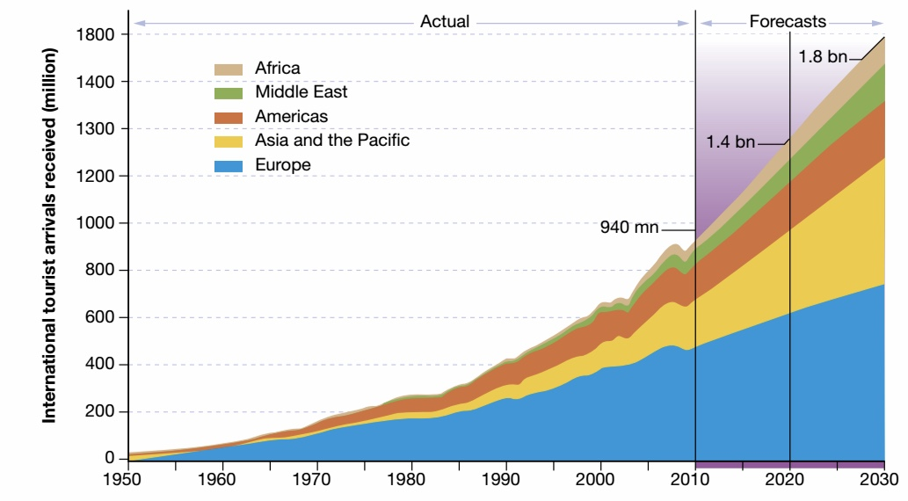

Slide 4
Current Situation
Tourism has become the largest industry in the world
Major players in the international economy and one of the main source of income for developing countries – keen to capture a larger share of the international tourist market

Slide 5
Current Situation
Tourism has proven to be a resilient industry, maintaining growth despite global financial shocks and growing security concerns (terrorism)
What the future holds for tourism is uncertain…

Slide 6
1. Deeping Diversification
The tourism industry is undertaking a process of enlarging or varying its range of products or field of operation
For Example – specialised corners or niches are developing around people’s interests – Northern Ireland and Game of Thrones
For Example – Expedition Tourism for those with a thirst for exploration to remote places – Trekking across the Mongolian Steppe

Slide 7
1. Deeping Diversification
With the demand for niche tourism rising, tourism operators are always looking for new experiences to challenge and entice travelers.
The industry continues to diversify to take advantage of new opportunities

Slide 8
Technology
Technological innovations – transforming transportation
The future looks SUPERSONIC
Shrinking distances and time could revolutionise land transport
The beginning of the Fourth Industrial Revolution

Slide 9
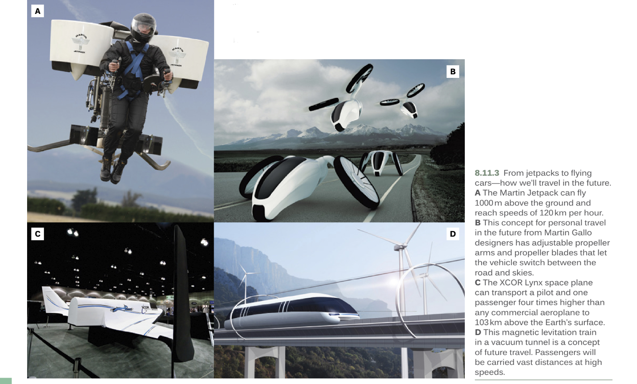
Technology Examples
https://7news.com.au/technology/space/space-travel-plans-could-see-passengers-flying-from-australia-to-the-uk-in-90-minutes-c-194071

Slide 10
Security Concerns
Tourists have acquired more freedom to travel – but this continued freedom remains uncertain
The geopolitical landscape is becoming more complicated with rising tensions between countries and the ongoing threat of terrorism

Slide 11
Security Concerns
Additional layers of security procedures and regulations may be put in place to reassure travelers
Stakeholders in the industry are working to share information and data across international borders to improve the safety of travelers

Slide 12
Climate Change
Tourism not only contributes to climate change but it is also affected by climate change
Climate change increases the frequency and severity of weather events

Slide 13
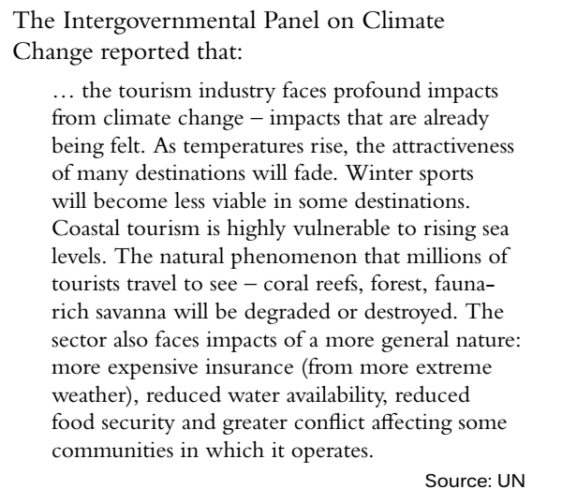

Slide 14
Unit 8.11 – The Future of Tourism
Pages 323 – 326
Activities 1 – 5 and 7 on page 325

Slide 15
Units Covered So Far
World Cities – Unit 4.2, Case Study Australia, Unit 4.3 London
Tourism – 8.1,8.2,8.3,8.4,8.5,8.6,8.8,8.10,8.11

